Slide 1
Lecture 3
Family Planning & Contraception

Slide 2
Family Planning
The use of various methods of fertility control that will help individuals or couples to have the number of children they want and when they want them in order to assure the well being of children and the parents

Slide 3
Family Planning Services
Desired number of children
Reduce the number of unwanted pregnancies
Reduce the risk of sexually transmitted infection
Improve the health of women and children by spacing birth

Slide 4
Contraception
Intentional prevention of conception or impregnation through the use of various devices, agents, drugs, sexual practices or surgical

Slide 5
Types of Birth Control
Hormonal
Barrier
IUD
Methods based on information
Permanent sterilization

Slide 6
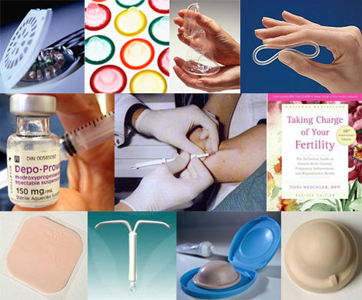

Slide 7
Hormonal Methods
Oral Contraceptives
(Birth Control Pill)
Injections (Depo-Provera)
Implants (Norplant I & II)

Slide 8
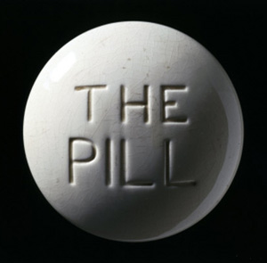
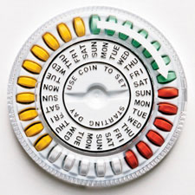
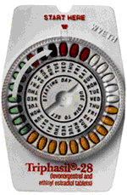
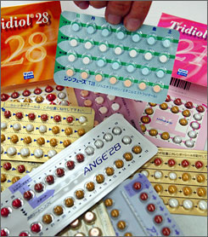
Birth Control Pills
Pills can be taken to prevent pregnancy
Pills are safe and effective when taken properly
Pills are over 99% effective
Women must have a pap smear to get a prescription for birth control pills
Pills DO NOT prevent STD’s

Slide 9
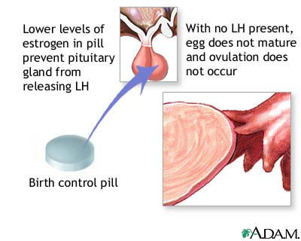
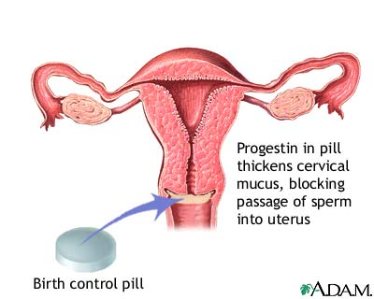
How does the pill work?
Stops ovulation
Thins uterine lining
Thickens cervical mucus

Slide 10
Benefits of Birth Control Pills
  Prevents pregnancy
  Eases menstrual cramps
  Shortens period
  Regulates period
  Decreases incidence of ovarian cysts
  Prevents ovarian and uterine cancer
  Decreases acne

Slide 11
Side-Effects
Breast tenderness
Nausea
Increase in headaches
Moodiness
Weight change
Spotting

Slide 12
Taking the Pill
Once a day at the same time everyday
Use condoms for first month
Use condoms when on antibiotics
Use condoms for 1 week if you miss a pill or take one late
The pill offers no protection from STD’s

Slide 13
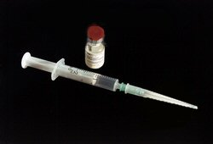
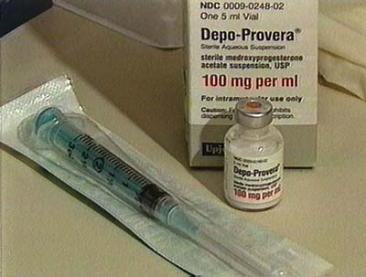
Depo-Provera
Birth control shot given once every three months to prevent pregnancy
99.7% effective preventing pregnancy
No daily pills to remember

Slide 14
How does the shot work?
The same way as the Pill
Stops ovulation
Stops menstrual cycles
Thickens cervical mucus

Slide 15
SIDE EFFECTS
Extremely irregular menstrual bleeding and spotting for 3-6 months!
NO PERIOD ☺ after 3-6 months
Weight change
Breast tenderness
Mood change
*NOT EVERY WOMAN HAS SIDE-EFFECTS!

Slide 16
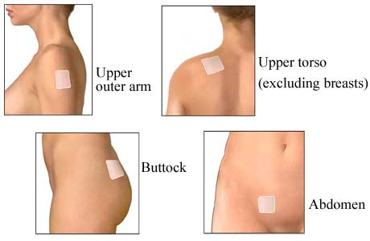
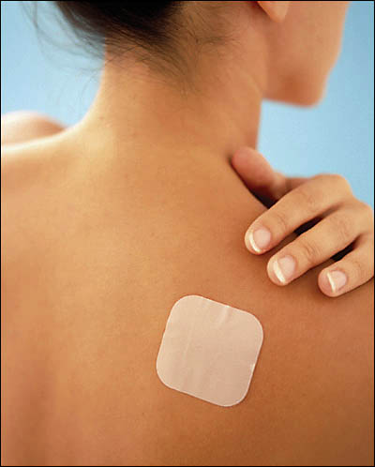
The Patch

Slide 17
… The Patch
It releases norelgestromin and ethinyl estradiol
Weekly applied, for 3 weeks, and the last week of the cycle is a patch-free week
Normal activities can be done while using the patch

Slide 18
IMPLANTS
Implants are placed in the body filled with hormone that prevents pregnancy
Physically inserted in simple 15 minute outpatient procedure
Plastic capsules the size of paper matchsticks inserted under the skin in the arm
99.95% effectiveness rate

Slide 19
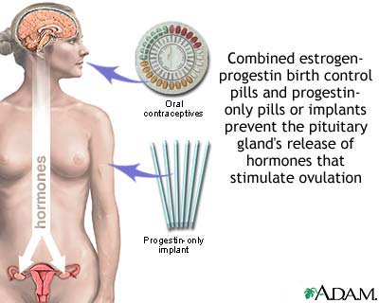
Norplant I vs. Norplant II
Six capsules
Five years
Two capsules
Three years

Slide 20
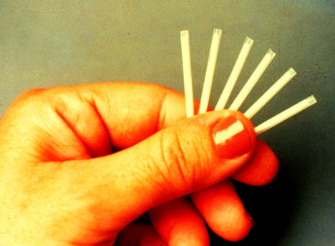
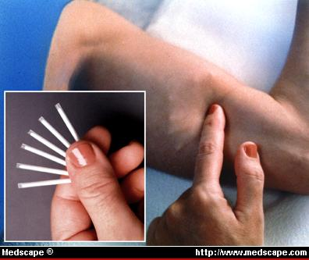
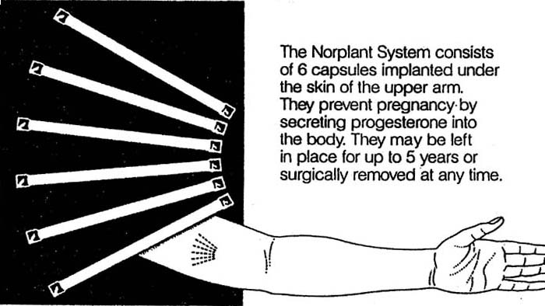
Norplant Implant

Slide 21
Norplant Considerations
Should be considered long term birth control
Requires no upkeep ☺
Extremely effective in pregnancy prevention > 99%

Slide 22
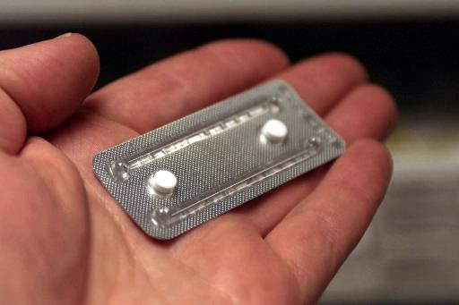
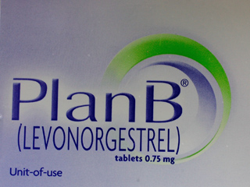

Emergency contraception pills can reduce the chance of a pregnancy by 75% if taken within 72 hours of unprotected sex!
Emergency Contraception (EP)

Slide 23
… Emergency Contraception
Must be taken within 72 hours of the act of unprotected intercourse or failure of contraception method
Must receive ECP from a physician
75 – 84% effective in reducing pregnancy

Slide 24
… Emergency Contraception
Floods the ovaries with high amount of hormone and prevents ovulation
Alters the environment of the uterus, making it disruptive to the egg and sperm
Two sets of pills taken exactly 12 hours apart

Slide 25
BARRIER METHODS
Spermicides
Male Condom
Female Condom
Diaphragm
Cervical Cap

Slide 26
… BARRIER METHODS
Prevents pregnancy blocks the egg and sperm from meeting
Barrier methods have higher failure rates than hormonal methods due to design and human error

Slide 27
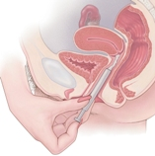
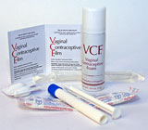
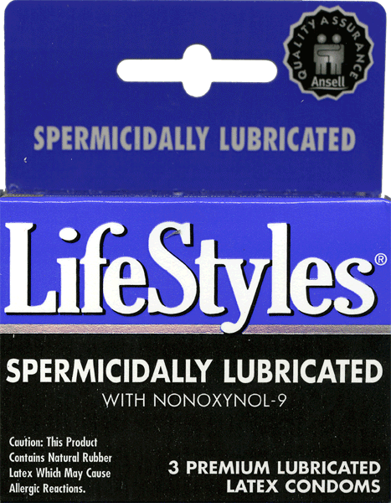
SPERMICIDES
Chemicals kill sperm in the vagina
Different forms:
-Jelly -Film
-Foam -Suppository
Some work instantly, others require pre-insertion
Only 76% effective (used alone), should be used in combination with another method i.e., condoms

Slide 28
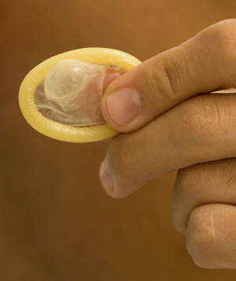
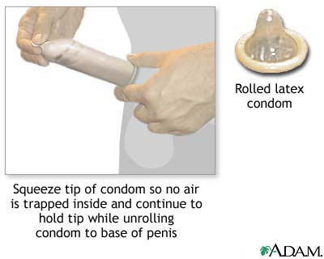
MALE CONDOM
Most common and effective barrier method when used properly
Latex and Polyurethane should only be used in the prevention of pregnancy and spread of STD’s (including HIV)

Slide 29
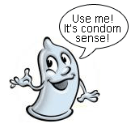
… MALE CONDOM
Perfect effectiveness rate = 97%
Typical effectiveness rate = 88%
Latex and polyurethane condoms are available
Combining condoms with spermicides raises effectiveness levels to 99%

Slide 30
FEMALE CONDOM
Made as an alternative to male condoms
Polyurethane
Physically inserted in the vagina
Perfect rate = 95%
Typical rate = 79%
Woman can use female condom if partner refuses

Slide 31
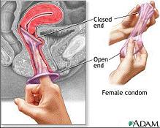
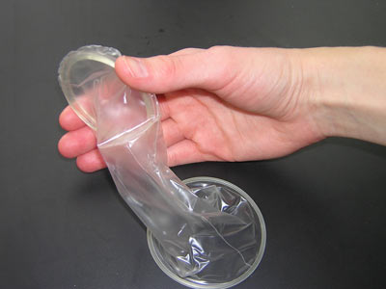
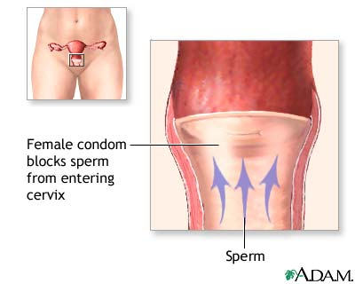
Reality ™ : The Female Condom

Slide 32
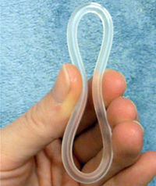
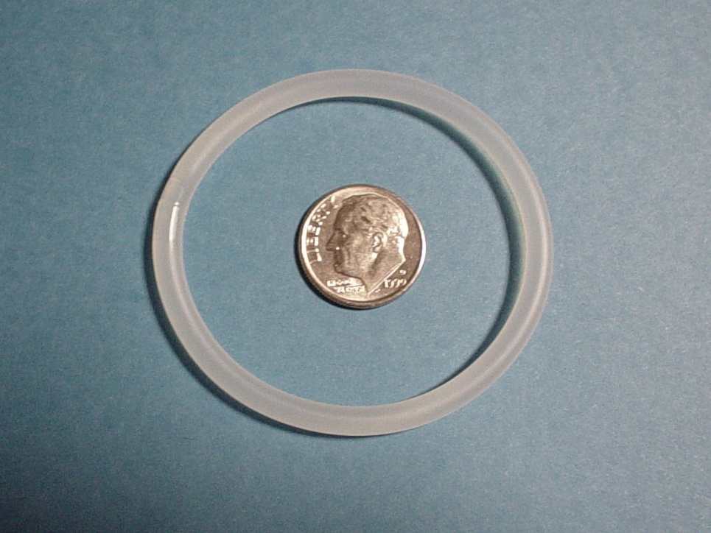
Vaginal Ring (NuvaRing)
95-99% Effective A new ring is inserted into the vagina each month
Does not require a "fitting" by a health care provider, does not require spermicide, can make periods more regular and less painful, no pill to take daily, ability to become pregnant returns quickly when use is stopped.
NuvaRing is a flexible plastic (ethylene-vinyl acetate copolymer) ring that releases a low dose of a progestin and an estrogen over 3 weeks.

Slide 33
DIAPHRAGM
Perfect Effectiveness Rate = 94%
Typical Effectiveness Rate = 80%
Latex barrier placed inside vagina during intercourse
Fitted by physician
Spermicidal jelly before insertion
Inserted up to 18 hours before intercourse and can be left in for a total of 24 hours

Slide 34
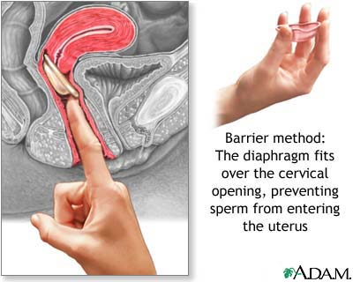
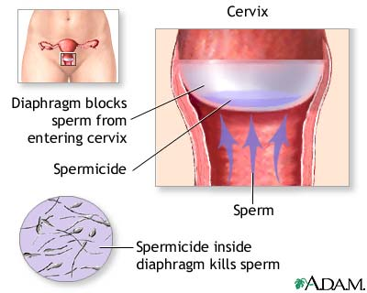
... DIAPHRAGM

Slide 35
CERVICAL CAP
Latex barrier inserted in vagina before intercourse
“Caps” around cervix with suction
Fill with spermicidal jelly prior to use
Can be left in body for up to a total of 48 hours
Must be left in place six hours after sexual intercourse
Perfect effectiveness rate = 91%
Typical effectiveness rate = 80%

Slide 36
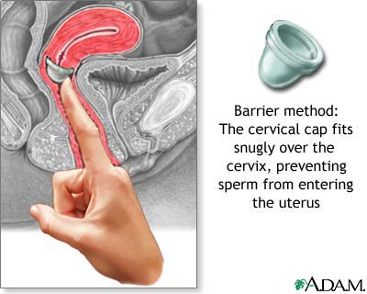
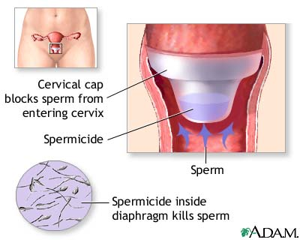
… Cervical Cap

Slide 37
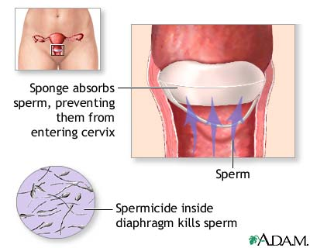
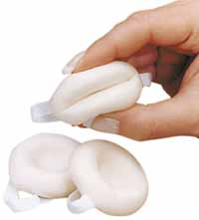
Sponge
The sponge is inserted by the woman into the vagina and covers the cervix blocking sperm from entering the cervix. The sponge also contains a spermicide that kills sperm. It is available without a prescription

Slide 38
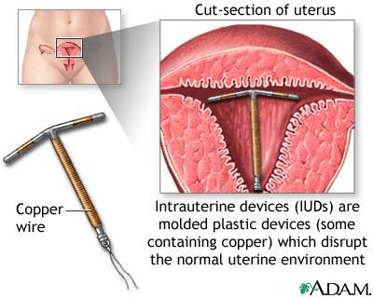
INTRAUTERINE DEVICES (IUD)
T-shaped object placed in the uterus to prevent pregnancy
Must be on period during insertion
A Natural childbirth required to use
IUD
Extremely effective without using hormones > 97 %
Must be in monogamous relationship

Slide 39
Copper T vs.. Progestasert
10 years
99.2 % effective
Copper on IUD acts as spermicide, IUD blocks egg from implanting
Must check string before sex and after shedding of uterine lining.
1 year
98% effective
T shaped plastic that releases hormones over a one year time frame
Thickens mucus, blocking egg
Check string before sex & after shedding of uterine lining.

Slide 40
STERILIZATION
Procedure performed on a man or a woman permanently sterilizes
Female = Tubal Ligation
Male = Vasectomy

Slide 41
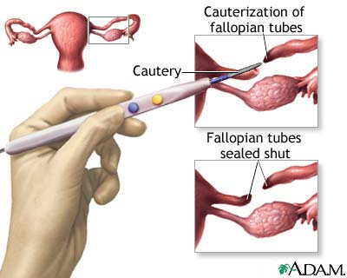
TUBAL LIGATION
Surgical procedure performed on a woman
Fallopian tubes are cut, tied, cauterized, prevents eggs from reaching sperm
Failure rates vary by procedure, from 0.8%-3.7%
May experience heavier periods

Slide 42
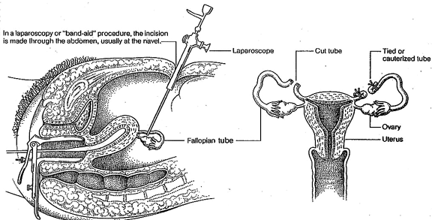
LAPAROSCOPY-’BAND-AID’ STERILIZATION

Slide 43
VASECTOMY
Male sterilization procedure
Ligation of Vas Deferens tube
No-scalpel technique available
Faster and easier recovery than a tubal ligation
Failure rate = 0.1%, more effective than female sterilization

Slide 44
… VASECTOMY
During a vasectomy (“cutting the vas”) a urologist cuts and ligates (ties off) the ductus deferens. Sperm are still produced but cannot exit the body. Sperm eventually deteriorate and are phagocytized. A man is sterile, but because testosterone is still produced he retains his sex drive and secondary sex characteristics.

Slide 45
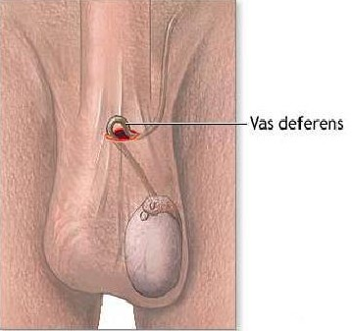
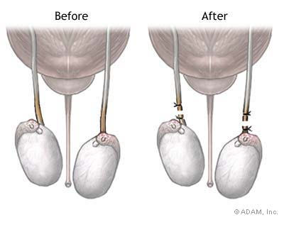
… VASECTOMY

Slide 46
METHODS BASED ON INFORMATION
Withdrawal
Natural Family Planning
Fertility Awareness Method
Abstinence

Slide 47
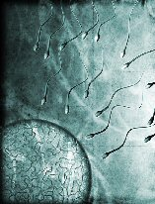

WITHDRAWAL
Removal of penis from the vagina before ejaculation occurs
NOT a sufficient method of birth control by itself
Effectiveness rate is 80% (very unpredictable in teens, wide variation)
1 of 5 women practicing withdrawal become pregnant
Very difficult for a male to ‘control’

Slide 48
Natural Family Planning
Women take a class on the menstrual cycle to calculate more fertile times
Requires special equipment and cannot be self-taught
NFP abstains from sex during the calculated fertile time

Slide 49
Fertility Awareness Method
FAM uses barrier methods during fertile time
Perfect effectiveness rate = 91%
Typical effectiveness rate = 75%
No 100% safe day-irregular periods

Slide 50
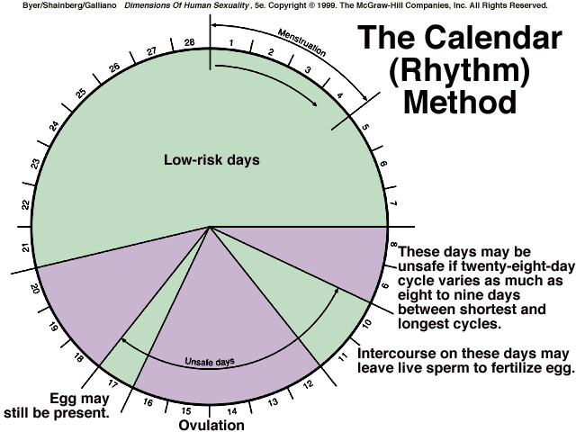

Slide 51
Contraception Prevalence Rate
No. of women using contraception * 100
No. of women ages 15-49

Slide 52
Married Women
15-49 – World [2017]

Slide 53
Married Women
15-49 – Africa [2017]

Slide 54
Reasons for non-use of Contraception
Fertility related
Opposition to use
Lack of knowledge
Method related reasons

Slide 55
Fertility Related
Not having sex
Infrequent sex
Menopausal
Postpartum infecundability
Breastfeeding

Slide 56
Opposition to Use
Partner opposed
Religious prohibition

Slide 57
Lack of Knowledge
Knows no method
Knows no source

Slide 58
Method Related Reasons
Health concerns
Fear side effects
Lack of access
Expensive
Inconvenient to use
Interference with body processes

Slide 59

Thank you

